Slide 1
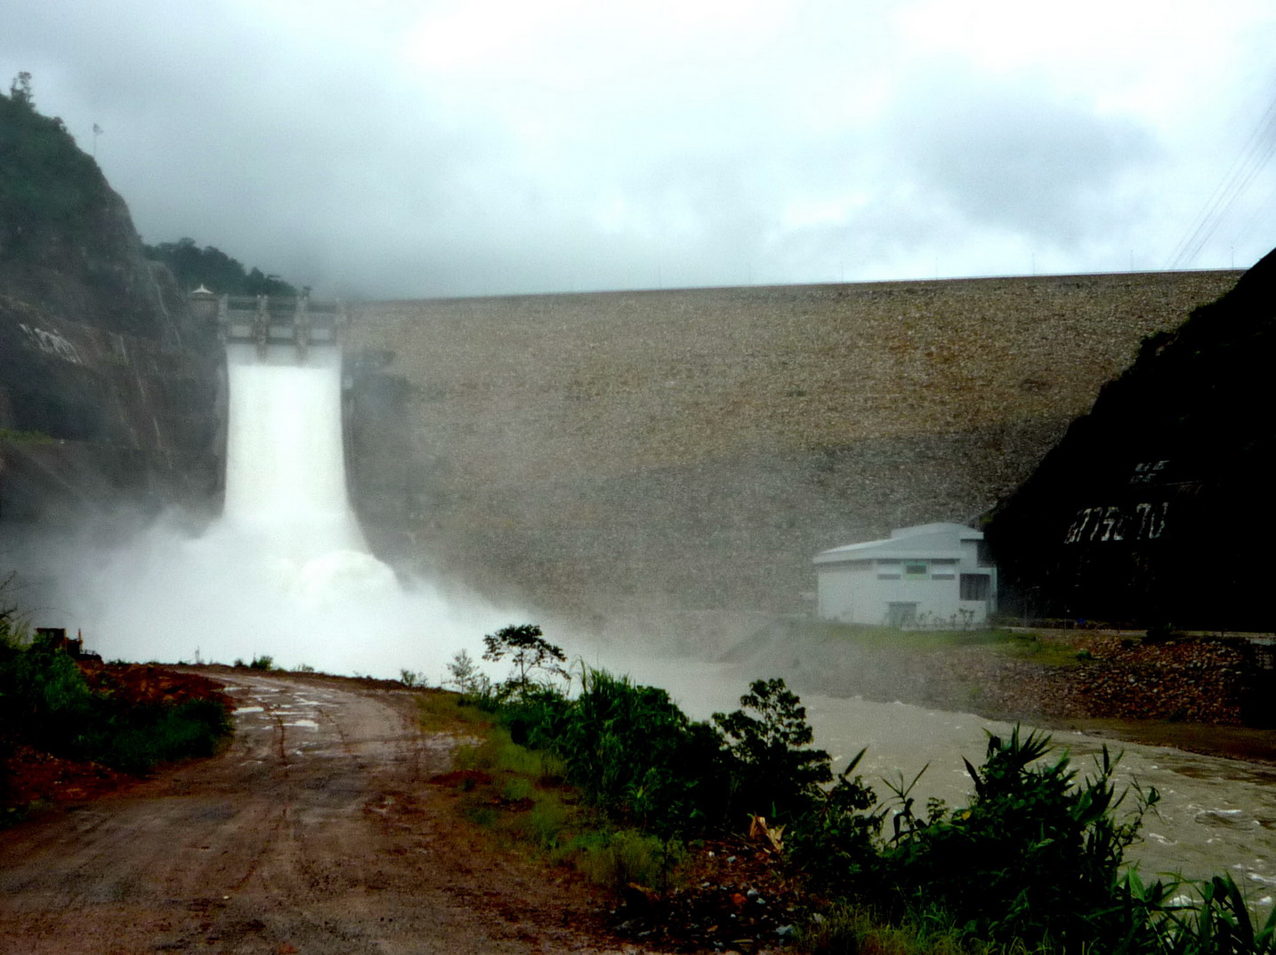


Deformation of Nam Ngum 2 concrete faced rockfill dam (CFRD)in Laos after construction
Dr. Warakorn Mairaing,
Chinoros Thongthumachat
GERD, Kasetsart University,
Bangkok, Thailand

Slide 2
Contents
Introduction to NN2 Dam
Monitoring Instruments for NN2 Dam
Deformation of Dam Body
Deformation of Face Slab
Face Slab Joint Movements
Conclusion

Slide 3
NN2 Dam Project Layout
Foundation Grouting
Plinth and
Face Slab
Perimeter Joint

Slide 4
Dam Features

Slide 5

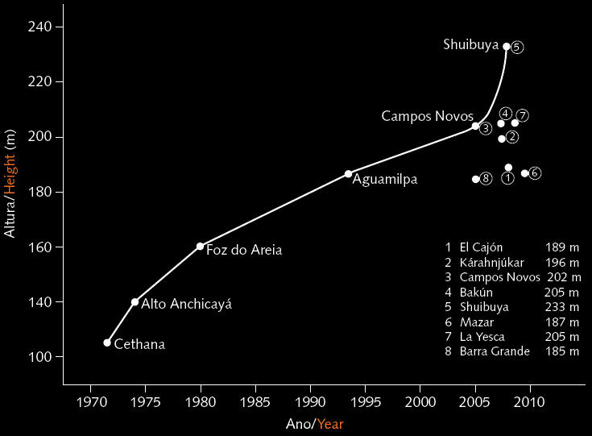
Progression of CFRD after the 60’s compacted rock-fill techniques
Nam Ngum2
(Cruz et al., 2009)

Slide 6
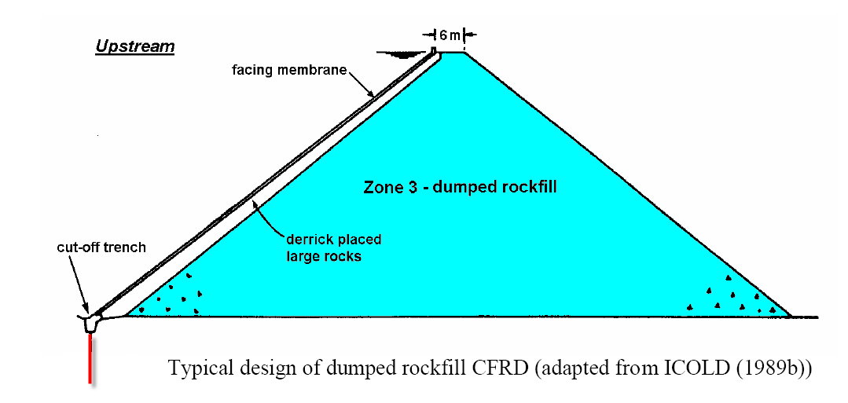

General Deformation Characteristics

Slide 7
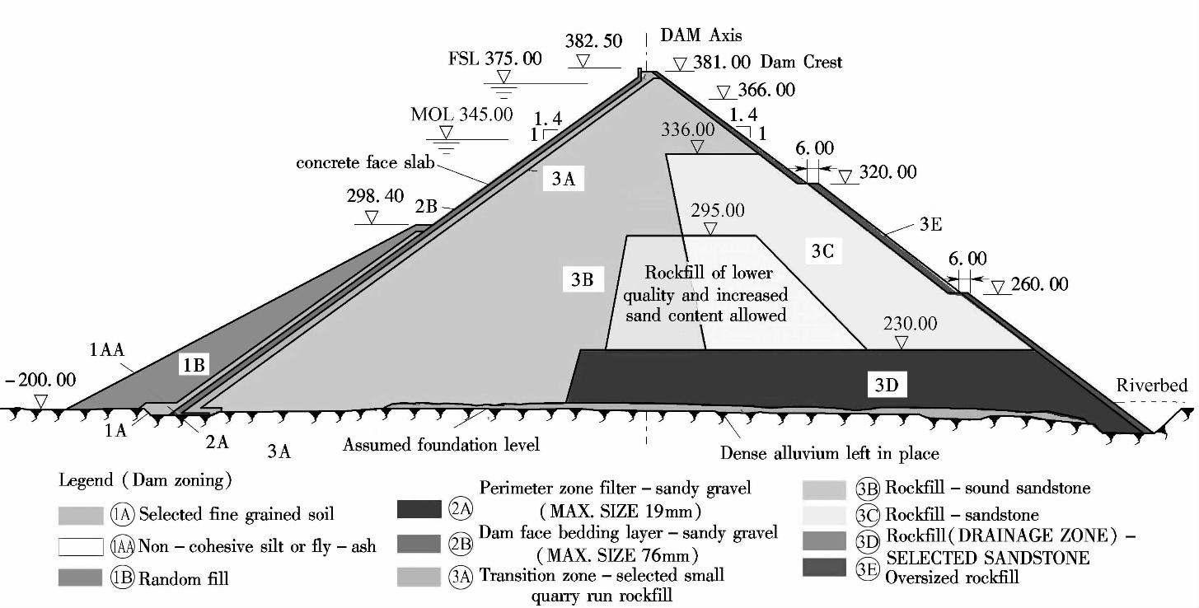
NN2 Dam Section
Coarser particles

Slide 8
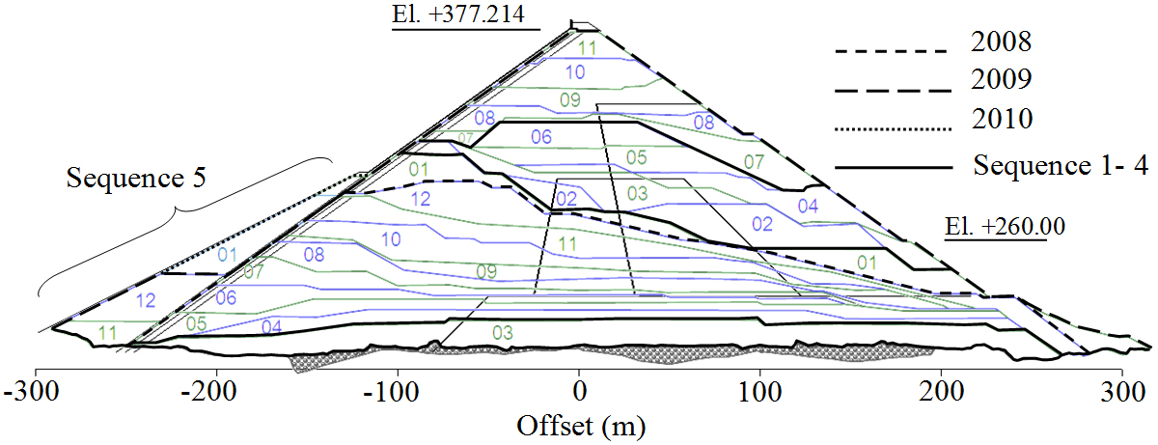
The dam construction
After Panarat K. (2011)
γ ≥ 21.5 kN/m³
July to November 2009, about 5 months
e_{max}= 0.2
El. + 315 m asl
2nd stage of face slab
0.80 m lift thickness
February - June 2009, about 5 months
115m
Feb 2008 – Nov 2009
April 2008 - January 2009, about 10 months.
1st stage of face slab
March 2008
2006
Sequence 1 consists of Zone 3B and 3D
The actual placement commenced on March 2008 of 10 m height start from downstream and left about 30 m at upstream path for construct the plinth at river bed.
Started on 2006
The river bed was cleaned and the foundation was improved before the commencement of embankment work
Dam body began to embank on February 2008
The embankment constructed within 20 months
The main dam embankment has mainly divided into 5 sequences.
The compacted sandstone rockfill has been controlled to achieve the dry unit weight more than 21.5 kN/m³ and the maximum of void ratio 0.20.
The 0.80 m lift thickness of 3B and 3C material has been employed depending on the maximum size of rockfill material.
Sequence 2 started from April 2008 to January 2009, about 10 months.
The placement of rockfill on the upstream was done up to elevation 315 m asl, which corresponds to 115m in height.
Sequence 4 after completion of the first stage concrete face slab then start compacted the embankment till the elevation reach to the wave wall foundation. The work took about 5 months started from July to November 2009.
Sequence 3 had to construct parallel with the first stage of face slab construction. Started from February to June 2009, about 5 months
Then started the Sequence 5, the second stage face slab started commencement in December 2009 parallel with the earthfill and random fill placed on upstream face over the lower part of the face slab, Zone 1A and 1B, have also been compacted.
After completion of the second stage face slab and the wave wall, the last portion of embankment above the wave wall foundation was constructed
8
Notes:
8
8
The construction project was started on 2006.
The river bed was cleaned and the foundation was improved before the commencement of embankment work.
Dam body began to embank on February 2008.
The embankment constructed within 20 months.
The main dam embankment has mainly divided into 5 sequences.

Slide 9

Summary of dam instruments in NN2 Dam
______________________________________________________________________________________________________
Instrumentation Notation Quantity Location
_______________________________________________________________________________________
Surface Monuments SM 14 Rockfill Upstream slope
21 Dam crest and Downstream slope
Inclinometer PI 3 sets Rockfill Downstream berm
Magnetic Settlement Gauge SG 41
Hydrostatic Settlement Cell HSC 22 Rockfill Section 2-4
Fixed Embankment Extensometer FEE 111 Rockfill Section 2-4
Total Earth Pressure Cell TPC 3 Rockfill Section 3
Strong Motion Accelerometer SMA 3 Rockfill Crest, downstream berm and abutment
Weather Station WS 1 set Rockfill Abutment
V-notch Measuring Weir VW 1 Rockfill Downstream toe
Open Standpipe Piezometer OSP 7 Rockfill Downstream of abutment and dam toe
Inclined Iinclinometer IIC 1 Face slab Section 3
Electro Level (Tilt Meter) EL 23 Face slab Section 1-4
1 Dimensional Joint Meter JM 4 set Face slab Parapet wall - face slab
2 Dimensional Joint Meter 2JM 10 set Face slab Between vertical joint
3 D (Perimetric) Joint Meter PJM 13 set Face slab Along perimetric - construction joint
3D Concrete Strain Gauge TSG 27 set Face slab Within concrete slab
Rebar Strain Gauge RBSG 27 Face slab Within concrete slab
Non Stress Strain Meter RBSG 7 Face slab Beneath concrete slab
Distributed Fiber Optic Temperature DFOT 900 m Plinth Beneath concrete slab
Vibrating Wire Piezometer VWP 35 Dam foundation
______________________________________________________________________________________________________
411 sensors
Notes:
There are several kinds of dam instrument on NN2 dam and about 485 sensors were installed within dam body and on the face slab.
-
Some instruments had been installed in dam foundation before filling of the dam embankment.

Slide 10
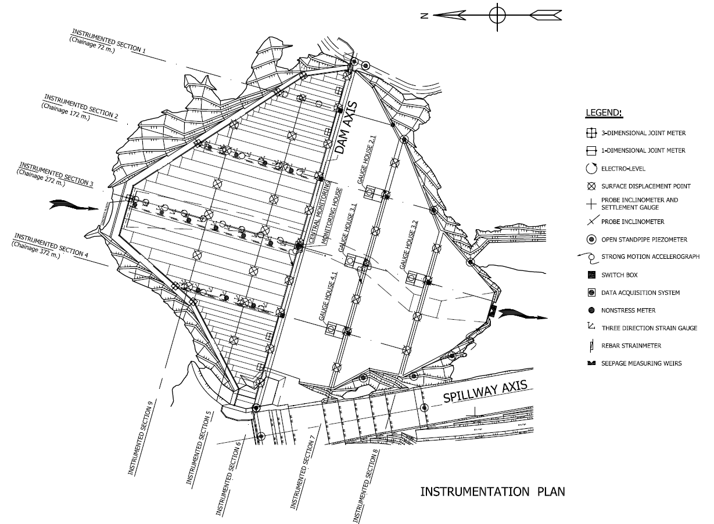
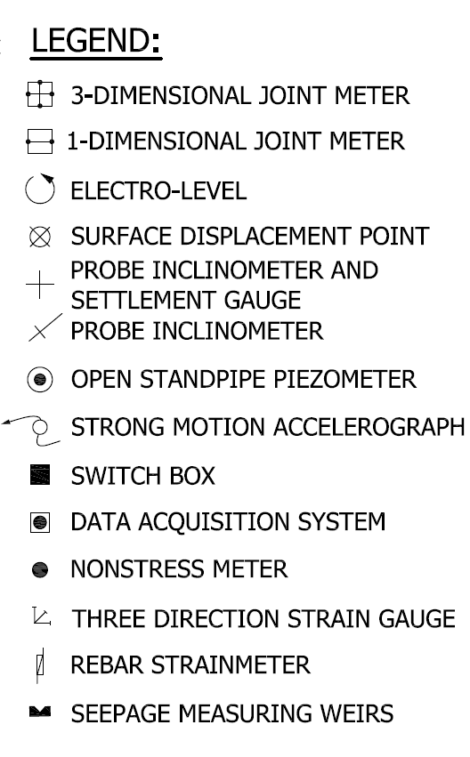
(TILTMETER)

Slide 11
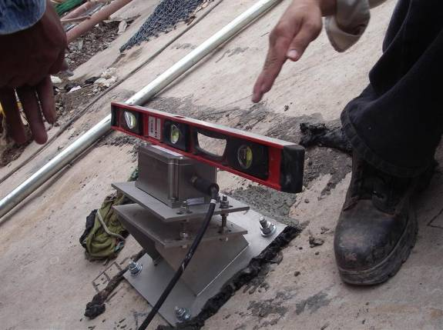
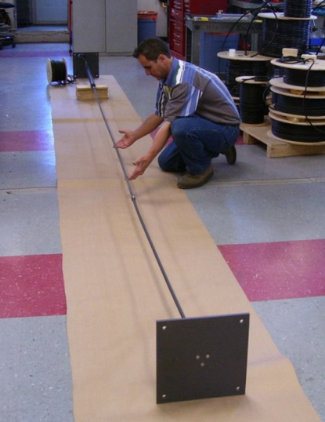
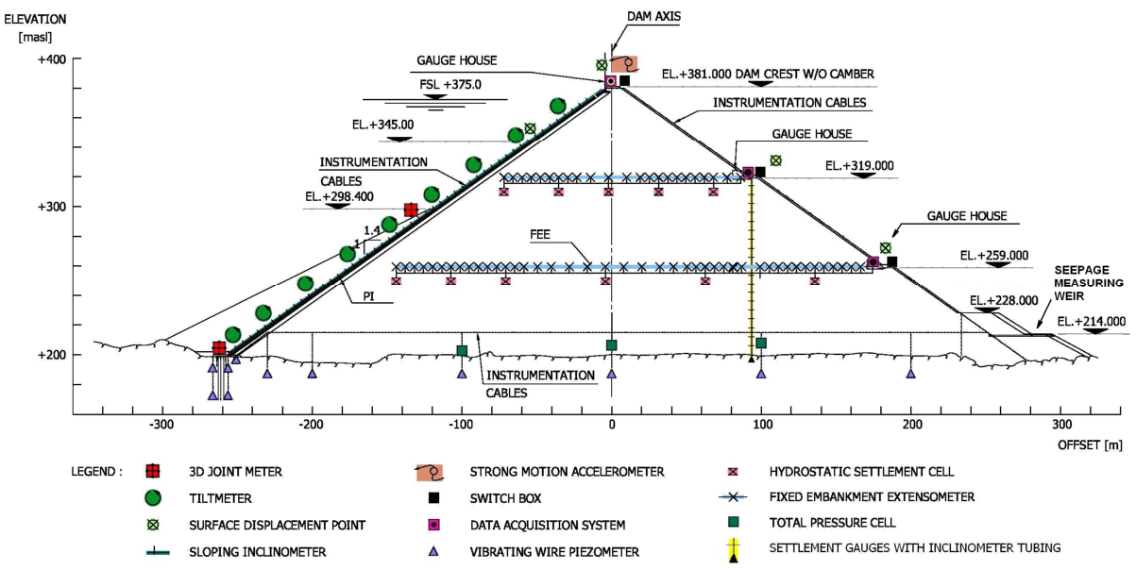

Tiltmeter
Embankment
Extensometer

Slide 12
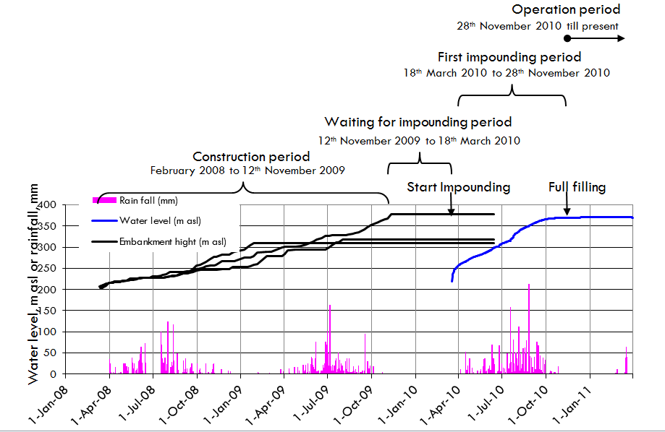
Construction and
Dam Operation
Timelines
3 years

Slide 13
Lateral Displacement on Plan View
Max. at SDP 6.5
Dis. = 150 mm.
SECTION E
December 2012
SECTION D
SECTION C
SECTION B
SECTION A

Slide 14
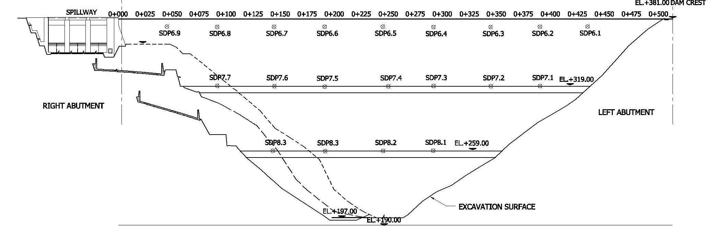
Displacement on Longitudinal Plane
14
110
199
221
246
222
200
140
69
39
133
157
175
160
103
25
Accumulative
Max. at SDP 6.5
Dis. = 246 mm.
22
31
39
14
Section A
Section E
Section B
Section D
Section C
18 DEC 12
2
3
5
6
5
6
8
6
2
0
1
1
3
4
3
0
Section A
Last 3 months
Maximum incremental displacement for last 2 months, at SDP 6.3
Dis. = 8 mm.
Section B
Section E
Section C
3
Section D
3
2
1
Looking upstream
4.0 mm/mo

Slide 15
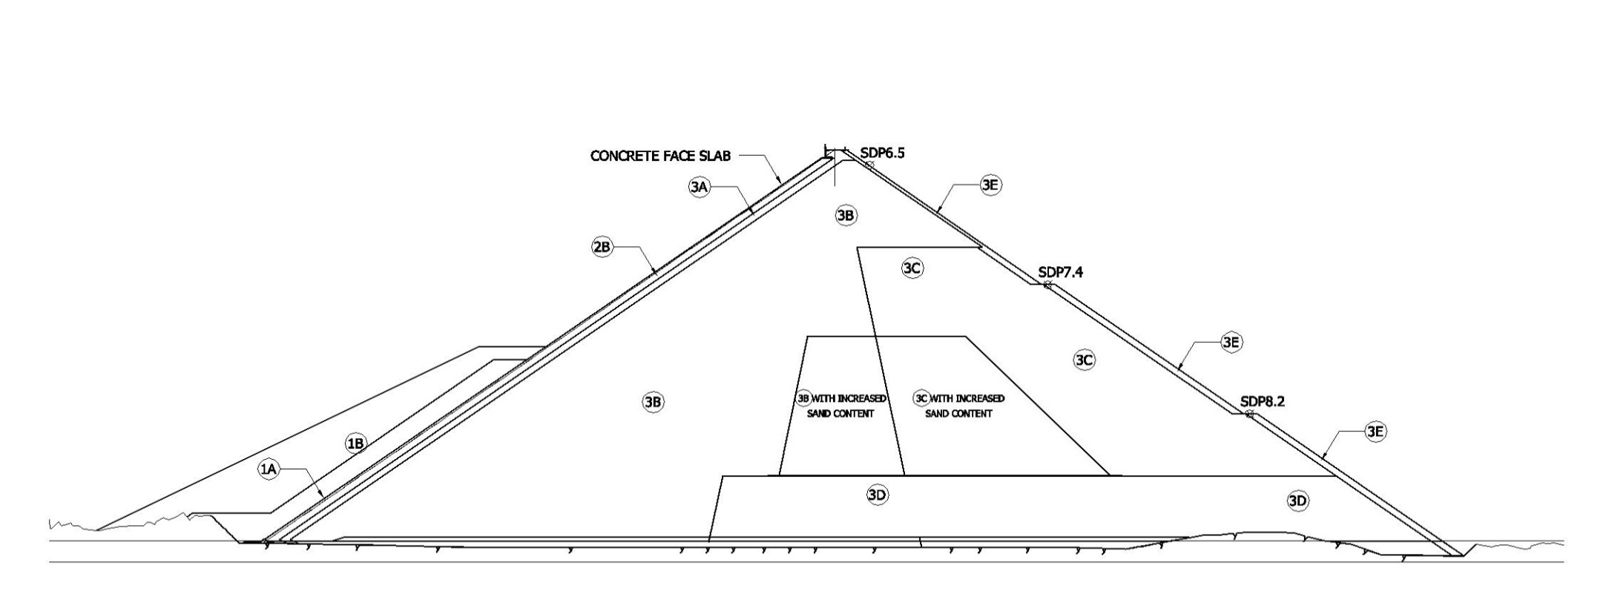
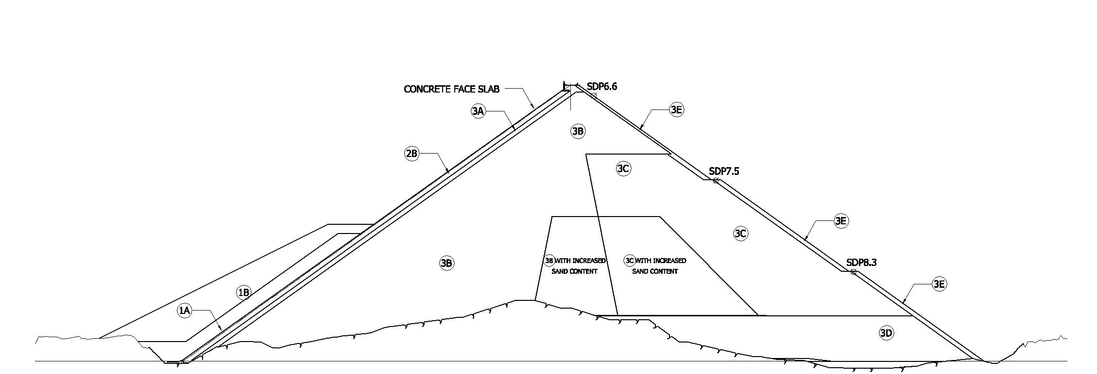
Displacements on Transverse Sections
Dis. at SDP 6.5
Mar = 168 mm.
June = 186 mm.
Sep = 223 mm.
Dec = 253 mm.
Apr = 261 mm.
Jul = 266 mm.
Oct = 281 mm.
Dec = 287 mm.
Section C
Maximum Section
Dis. at SDP 6.6
Mar = 153 mm.
Jun = 167 mm.
Sep = 200 mm.
Dec = 220 mm.
Apr = 230 mm.
Jul = 236 mm.
Oct = 248 mm.
Dec = 254 mm.
Section D
Right Abutment

Slide 16
Movement of Dam Surface
Along dam axis displacement with time
1st full filling
2nd full filling
3rd full filling
Haima 2011
Start Impounding
Construction
R
L

Slide 17
US/DS displacement with time
1st full filling
2nd full filling
3rd full filling
Haima 2011
Start Impounding
Finishing Works
+314
+257
+373
Crest

Slide 18
Settlement rates
Total Settlement
Construction Period
Finishing Period
Finishing Period
First filling
Second filling
Third filling
Smaller than 5.0 mm./month
It is obvious that the settlement was induced slower by the 3rd filling.
Settlement Rate

Slide 19
-0.02
-0.04
-0.06
-0.08
-0.10
-0.12
= 0.15-0.4 % in 10 Yrs for medium strength rockfill
(Hunter et al, 2003)
-0.14
= 0.05-0.25 for medium strength rockfill
(Hunter et.al., 2003)
Creep parameters decrease with time and related to the water level.

Slide 20
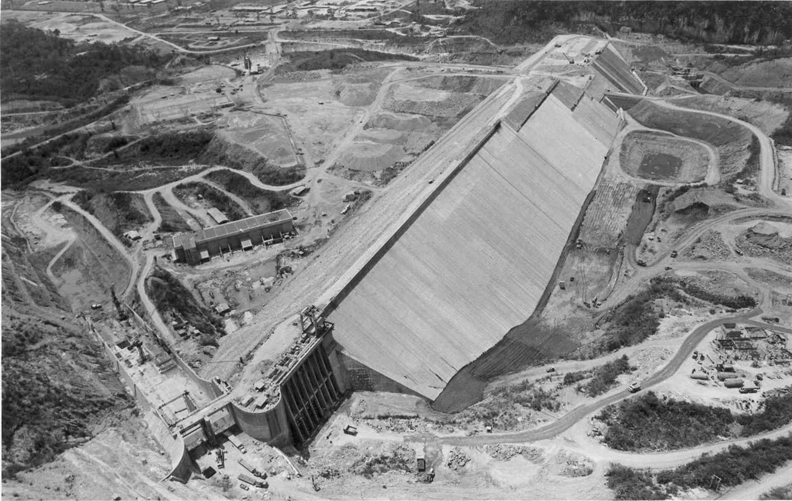
Crest Settlement in literatures
Post construction total crest settlement and long-term creep rate for CFRDs
(Hunter et al, 2003)
Rockfill Classification | Total Post Construction Settlement (% of dam height) |  | Long-term Creep Rate, α** (% /log cycle)
 | 10 years | 30 years
Dumped Rockfill | 0.6 to 1.0 | 1.0 to 1.5 | 0.3 to 1.5
Well Compacted Rockfills:
- Medium to high strength* | 0.15 to 0.4 | - | 0.05 to 0.25
- Very high strength, quarried* | 0.06 to 0.2 | - | 0.02 to 0.10
- Gravel Rockfills | 0.2 to <0.05 | - | <0.10
0.15 – 0.20
α < 0.10 For last filling
Note:
* Rock substance unconfined compressive strength medium 6 to 20 MPa, high 20 to 70 MPa, very high 70 to 240 MPa.
** %strain = α (log T₂ – log T₁)
Notes:
20

Slide 21
Relation of crest settlement and leakage
0.15% at Present
0.20-0.25% for 10 yrs.
35
35
0.35
0.35
Possible some leakage
30
30
0.30
0.30
25
25
0.25
0.25
20
20
0.20
0.20
Frequency
Probability Density
15
15
Almost certainly leak
0.15
0.15
10
10
0.10
0.10
5
5
0.05
0.05
0
0
0.00
0.00
0.1
0.1
0.4
0.4
0.6
0.6
0.9
0.9
1.1
1.1
1.3
1.3
1.6
1.6
1.8
1.8
2.1
2.1
%
Crest Settlement
%
%Settlement and possibility of leakage
Statistical data summarized by Hunter and Fell (2005) and GERD (2013)

Slide 22
Deformation of Face Slab

Slide 23
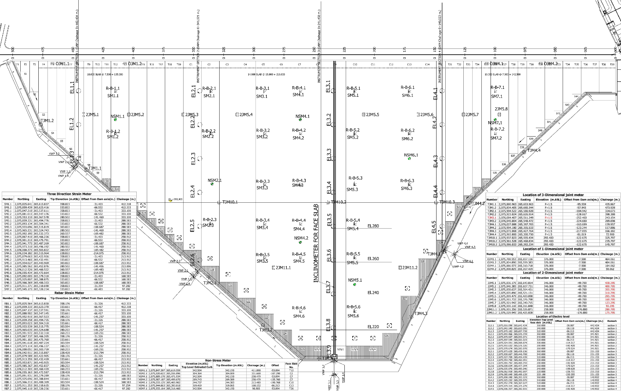
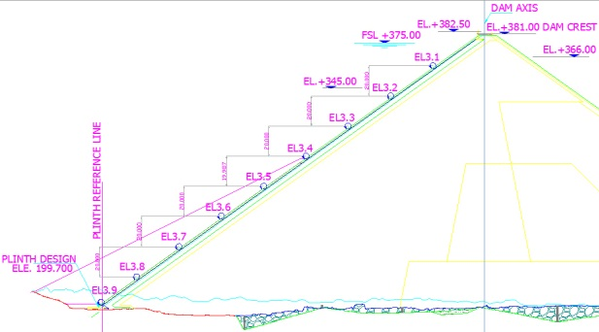
Face slab Deflection Instruments
Section 1 Ch. 372
Section 2 Ch. 272
Section 3 Ch. 172
Section 4 Ch. 72
1.1 2.1 3.1 4.1
2nd stage of face slab
1.2 2.2 3.2 4.2
1.3 2.3 3.3 4.3
2.4 3.4 4.4
2.5 3.5 4.5
1st stage of face slab
2.6 3.6 4.6
EL
TJM
3.7
Electro Level (EL)
3D joint meter (TJM)
EL
TJM
3.8
3.9
Section of dam
Face slab layout
Notes:
23
Electro Level were used for monitoring changes in rotation at the surface of face slab which interpreted with 3D joint meters.
TJMs measurement the joint movement between face slab and plinth and also between 1st and 2nd stage face slab.
The face slab deflections were interpret at 4 section.
23

Slide 24
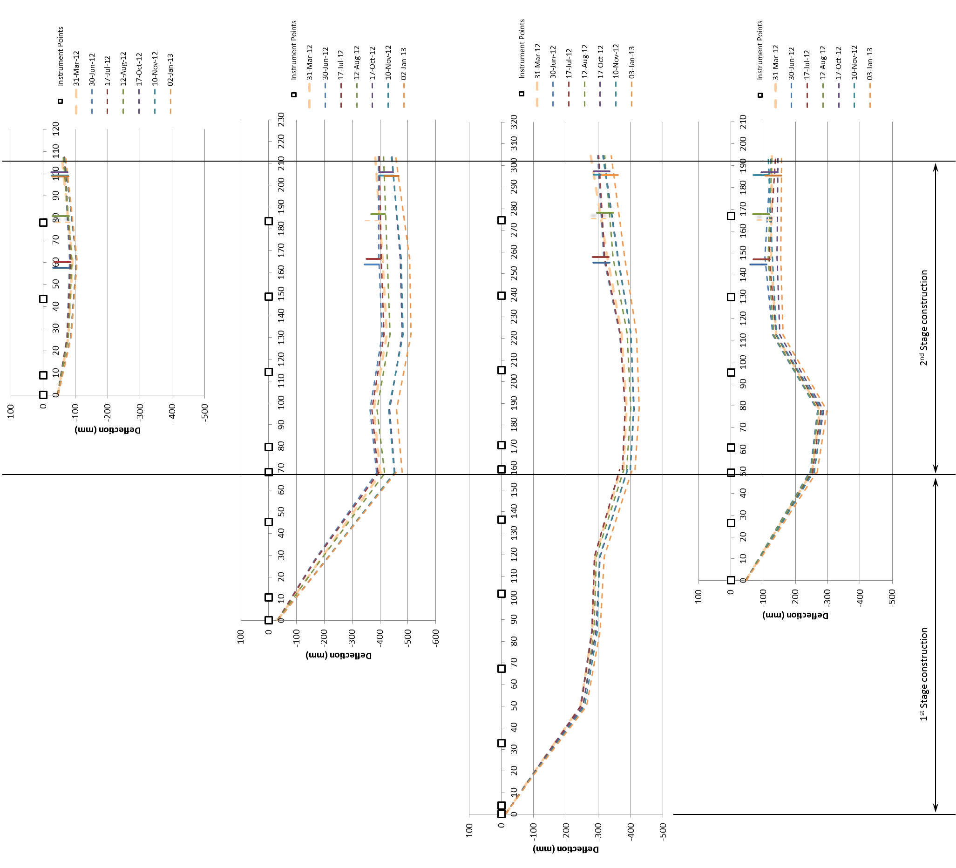
Deflection of face slab
Dam Crest
Max. =51 cm.
Max. =43 cm.
U/SToe
Max. =30 cm.
Max. =35 cm.
Section 1
U/SToe
U/SToe
Section 4
As of Jan 2013
Section 2
The concrete face slab has the deflect more than last 3 months still related to the RWL.
Section 3
U/SToe

Slide 25
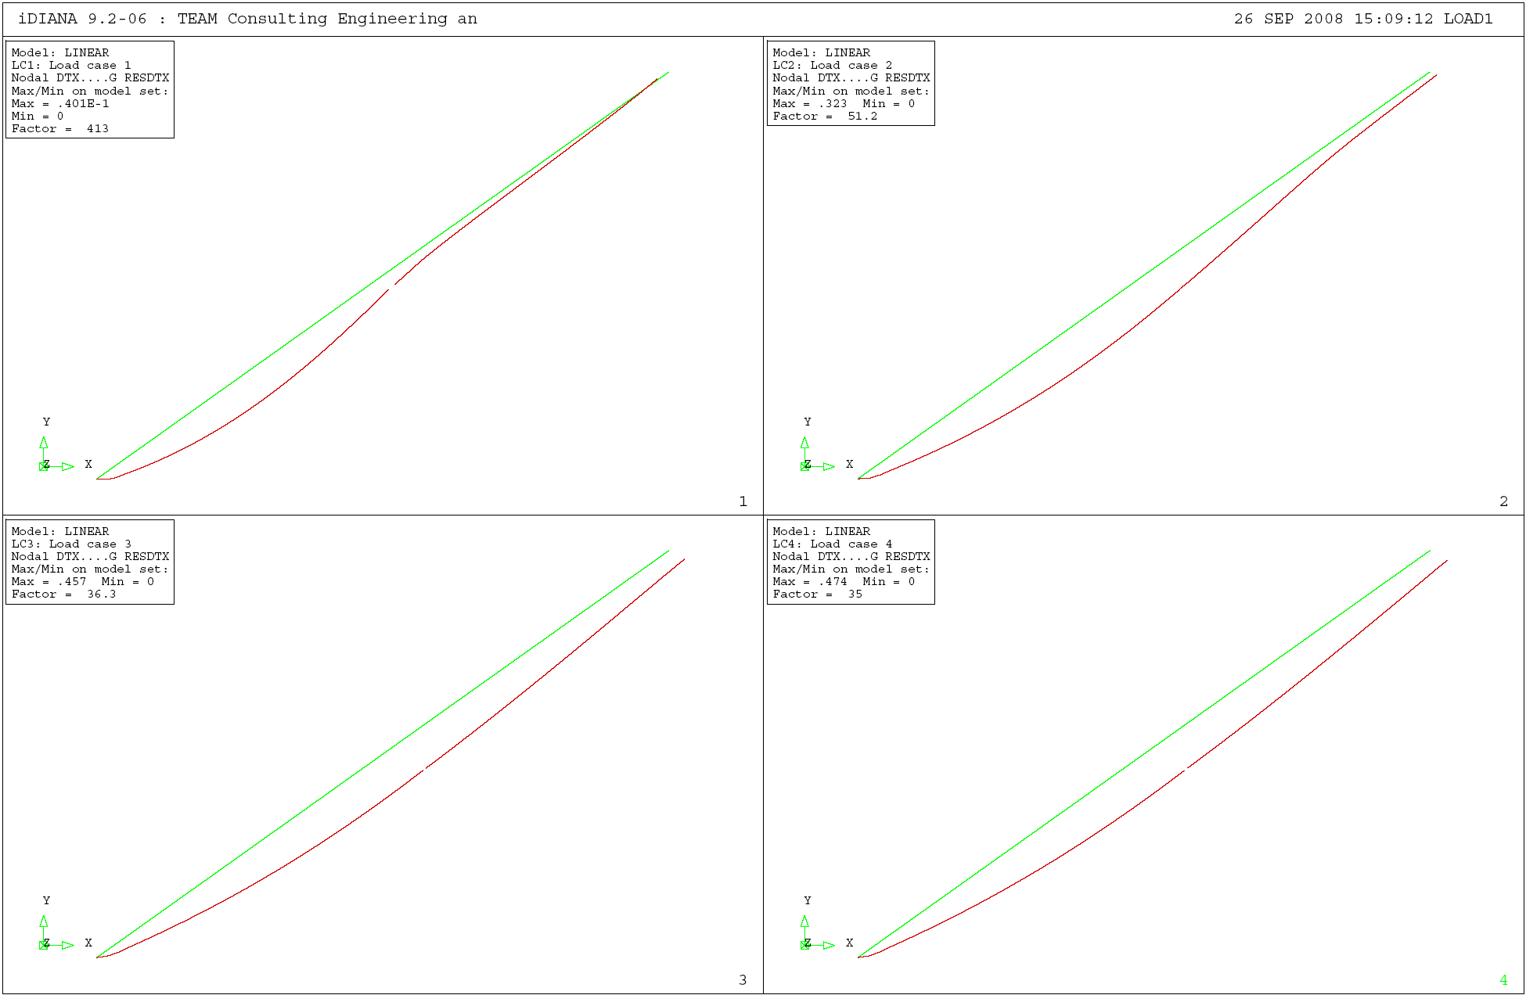
Predicted Deflections from Design
LC1. Reservoir (Empty)
LC2. Reservoir (MoL)
Max = 0.323 m
Max = 0.0401 m
LC3. Reservoir (FSL)
LC4. Reservoir (PMF)
Max = 0.457 m
Max = 0.474 m
Notes:
25

Slide 26
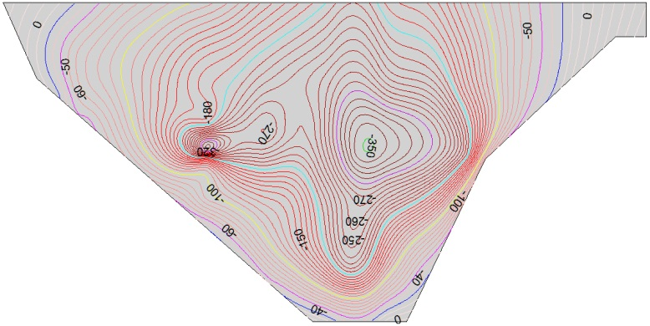
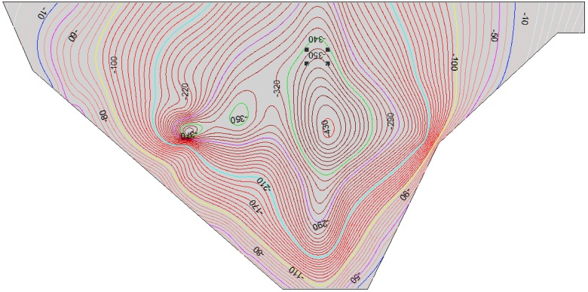
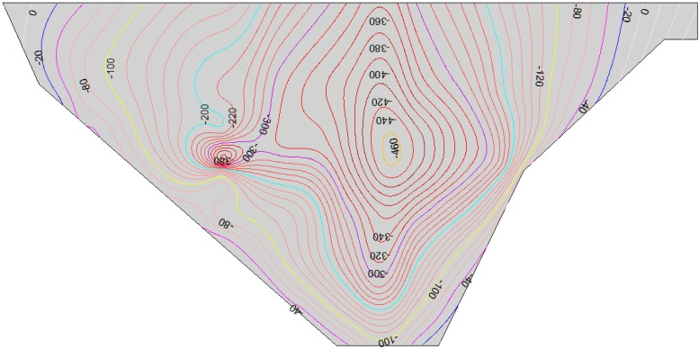
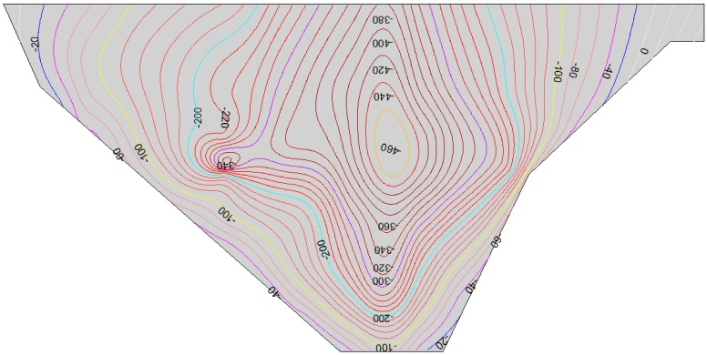
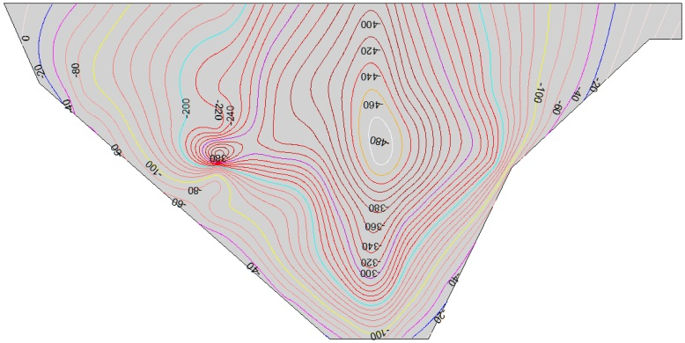
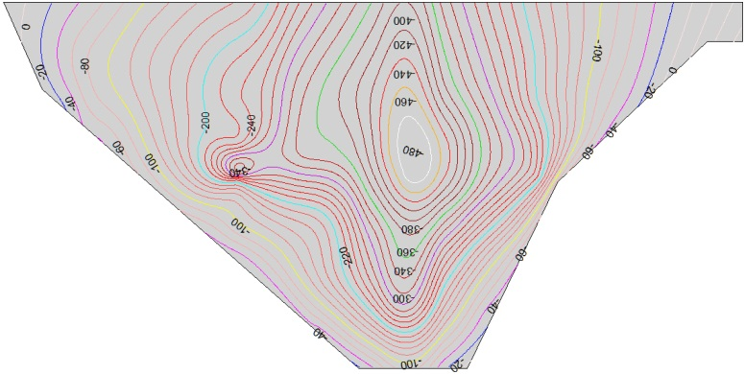
Contours of face slab deflection (in mm) during first impounding.
WL +368
WL +370
-350 mm
-430 mm
18 Oct 2010
18 Nov 2010
WL +370
WL +371
-460 mm
18 Dec 2010
18 Jan 2011
WL +371
WL +371
-480 mm
18 Feb 2011
18 Mar 2011

Slide 27
Face Slab Joint Movement

Slide 28
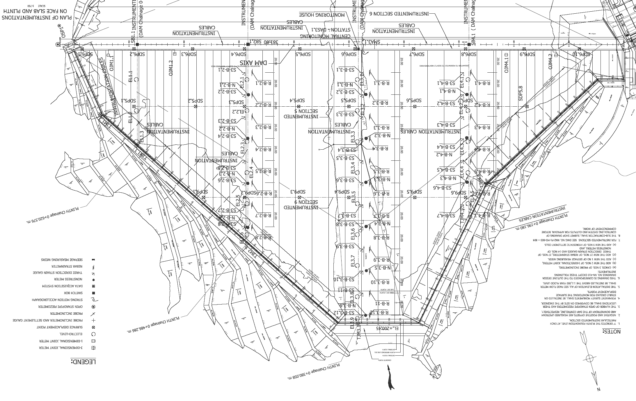
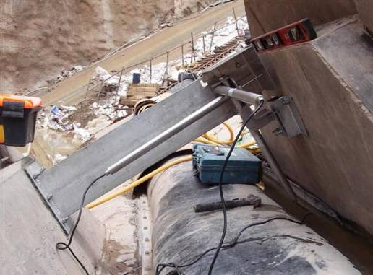
Location of Jointmeters (1D, 2D, 3D)
Perimetric Joint
Horizontal Construction Joint +285
3D Jointmeter 6 sets
3D Jointmeter (add.) 7 sets
2D Jointmeter (add.) 8 sets
1D Jointmeter 4 sets
Looking downstream
Notes:
28
fdsfiek

Slide 29
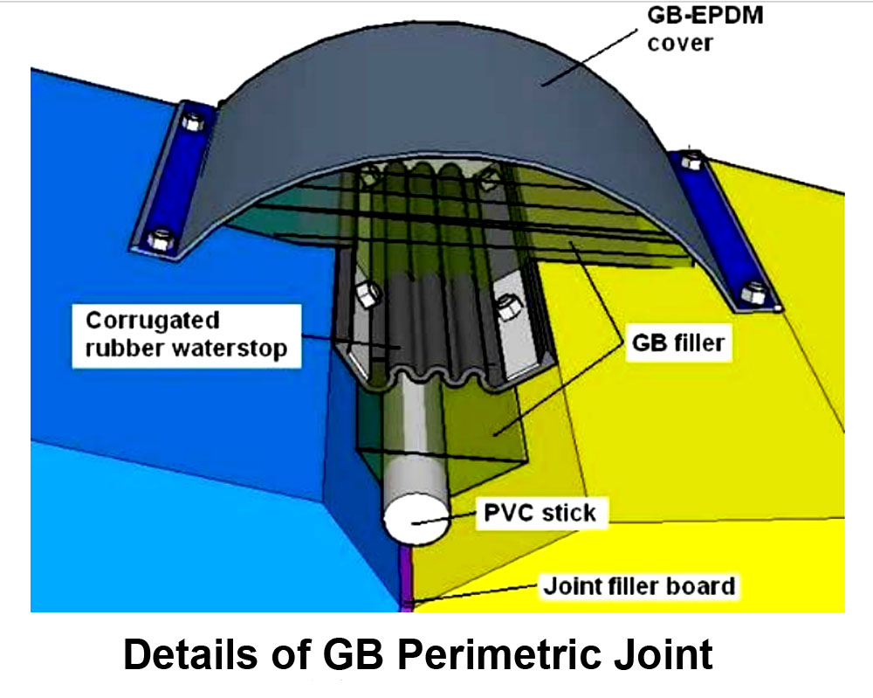
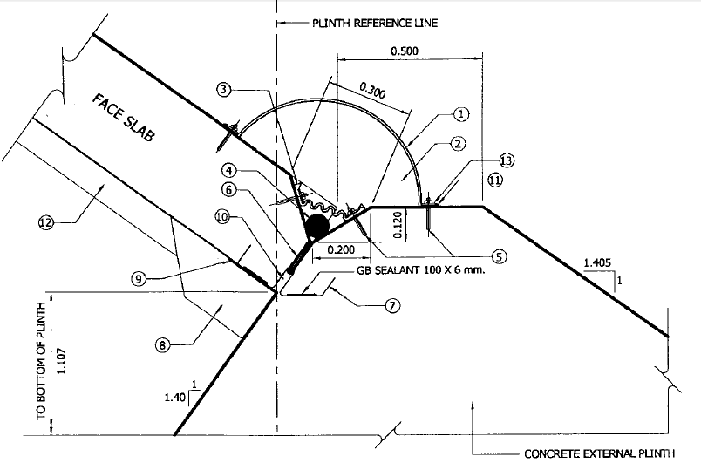
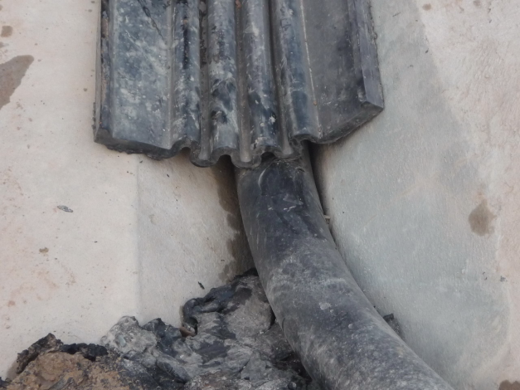
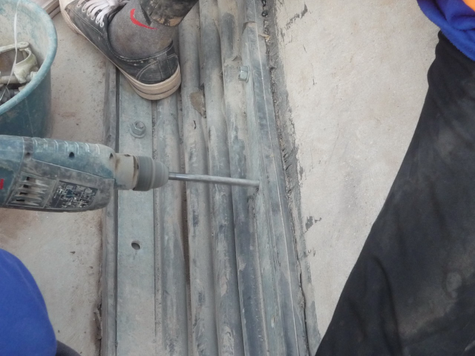
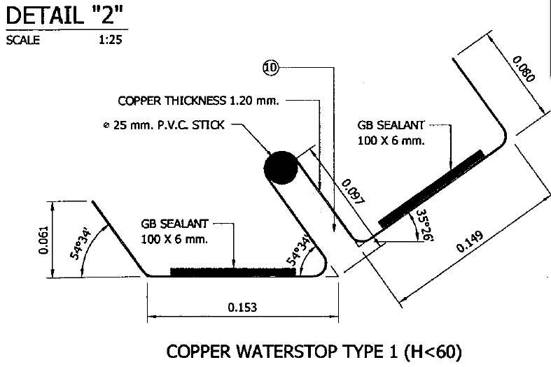
Perimeter Joint Details
Face Slab
Plinth Wall
Plinth Wall
Face Slab
Flexibility > 15 cm.

Slide 30
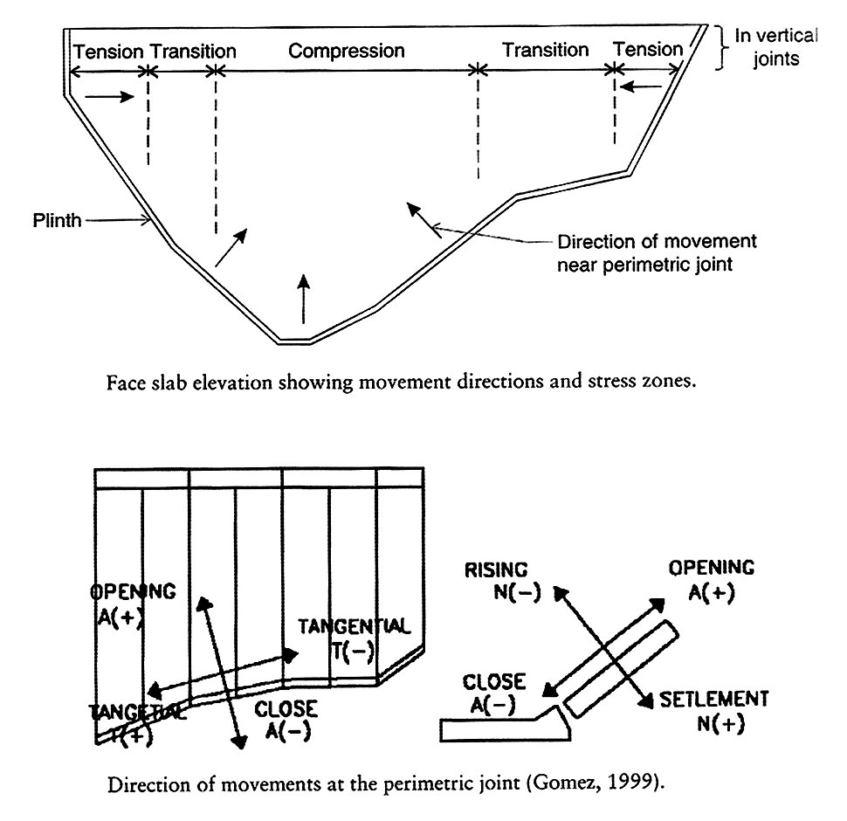
Three Direction (Perimetric) Jointmeter (TJM)
Y
X
Z
Perpendicular
Sign Notation: Movement of face concrete related to plinth
X (Perpendicular) direction
  + Opening, - Closing
Y (Parallel) direction
  + Toward to LA, - Toward to RA
Z (Settlement) direction
  + Upward, - Downward
Perpendicular
Parallel
Notes:
30

Slide 31
Joints Monitoring vs. Time
1st full filling
2nd full filling
3rd full filling
Haima 2011
Start Impounding
Construction
+314
+257
+373
Crest
1
2
3
4
5
6

Slide 32
Movement of Joints in May 10
1
Joint Closing
Joint Settlement
1st Filling
Joint Sliding
Sign Notation: Movement of face concrete related to plinth
X (Perpendicular) direction Y (Parallel) direction Z (Settlement) direction
+ Opening, - Closing + Toward to LT, - Toward to RT + Upward, - Downward

Slide 33
Movement of Joints in October 10
2
Joint Closing
Joint Settlement
1st Filling
Joint Sliding
Sign Notation: Movement of face concrete related to plinth
X (Perpendicular) direction Y (Parallel) direction Z (Settlement) direction
+ Opening, - Closing + Toward to LT, - Toward to RT + Upward, - Downward

Slide 34
Movement of Joints in June 11
3
2JM5.1 malfunction
Joint Closing
Joint Settlement
1st Filling
Joint Sliding
Sign Notation: Movement of face concrete related to plinth
X (Perpendicular) direction Y (Parallel) direction Z (Settlement) direction
+ Opening, - Closing + Toward to LT, - Toward to RT + Upward, - Downward

Slide 35
Movement of Joints in October 11
4
Joint Closing
Joint Settlement
2nd Filling
Joint Sliding
Sign Notation: Movement of face concrete related to plinth
X (Perpendicular) direction Y (Parallel) direction Z (Settlement) direction
+ Opening, - Closing + Toward to LT, - Toward to RT + Upward, - Downward

Slide 36
Movement of Joints in July 12
5
2JM5.8 fluctuated presumed fail
2JM5.1 fluctuated presumed fail
2JM5.2 fluctuated presumed fail
Joint Closing
Joint Settlement
3rd Filling
Joint Sliding
Sign Notation: Movement of face concrete related to plinth
X (Perpendicular) direction Y (Parallel) direction Z (Settlement) direction
+ Opening, - Closing + Toward to LT, - Toward to RT + Upward, - Downward

Slide 37
Movement of Joints in January 13
6
Joint Closing
Joint Settlement
3rd Filling
Joint Sliding
Sign Notation: Movement of face concrete related to plinth
X (Perpendicular) direction Y (Parallel) direction Z (Settlement) direction
+ Opening, - Closing + Toward to LT, - Toward to RT + Upward, - Downward

Slide 38
Rate of displacement at TJM 2.2
TJM 2.2
2010
2011
The joints have rate of movement increasing during first impounding (Jun to Aug 2010), then decreasing after fully impounding (Aug 2010 to Mar 2011) and then nearly to constant.
After 2nd impounding in Jul 2011, the rate of settlement slightly increased .
settlement
Displacement
Sign Notation: Movement of face concrete related to plinth
X (Perpendicular) direction
+ Opening, - Closing
Y (Parallel) direction
+ Toward to LT, - Toward to RT
Z (Settlement) direction
+ Upward, - Downward
Rate of Displacement
1st Filling
2nd Filling

Slide 39
Overall Relative Face Slab Movement
Focal Points

Slide 40
Conclusion
NN2 Dam in Laos PDR is a 182 m. high and one of the major CFRD in the world. The Thai investors was initiated and carried on this hydropower project. Thus the knowledge of dam behavior is very important not only for dam safety, O&M but also for the engineers to handle the future design and construction.
The deformation of CFRD during construction and initial stage of impounding is related to the leakage through dam. The integrity and water tightness of the face slab can also evaluate by the monitoring of face slab deflection and joint movements.
The maximum settlement of dam crest during 3 years of reservoir operation was 24.6 cm. or 0.15 % of dam height. This dam crest settlement is well below the critical deformation of 0.4 to 1.0% of dam height that can cause some crack on the face slab.

Slide 41
Conclusion (cont.)
During first impounding, the water level reach to +371 m asl, the maximum face slab deflection was 486 mm. as comparing to the anticipated deflection from the design analysis is of 457 mm. The contour of slab deflection indicated the maximum deflection occurring at approximately mid height on the deepest section.
The local maximum face slab settlement of 80 mm. was recorded at the beginning of the 1st impounding. This rate was slowed down after the first impounding and the settlement was still in the allowance of copper water stop and joint sealing.

Slide 42
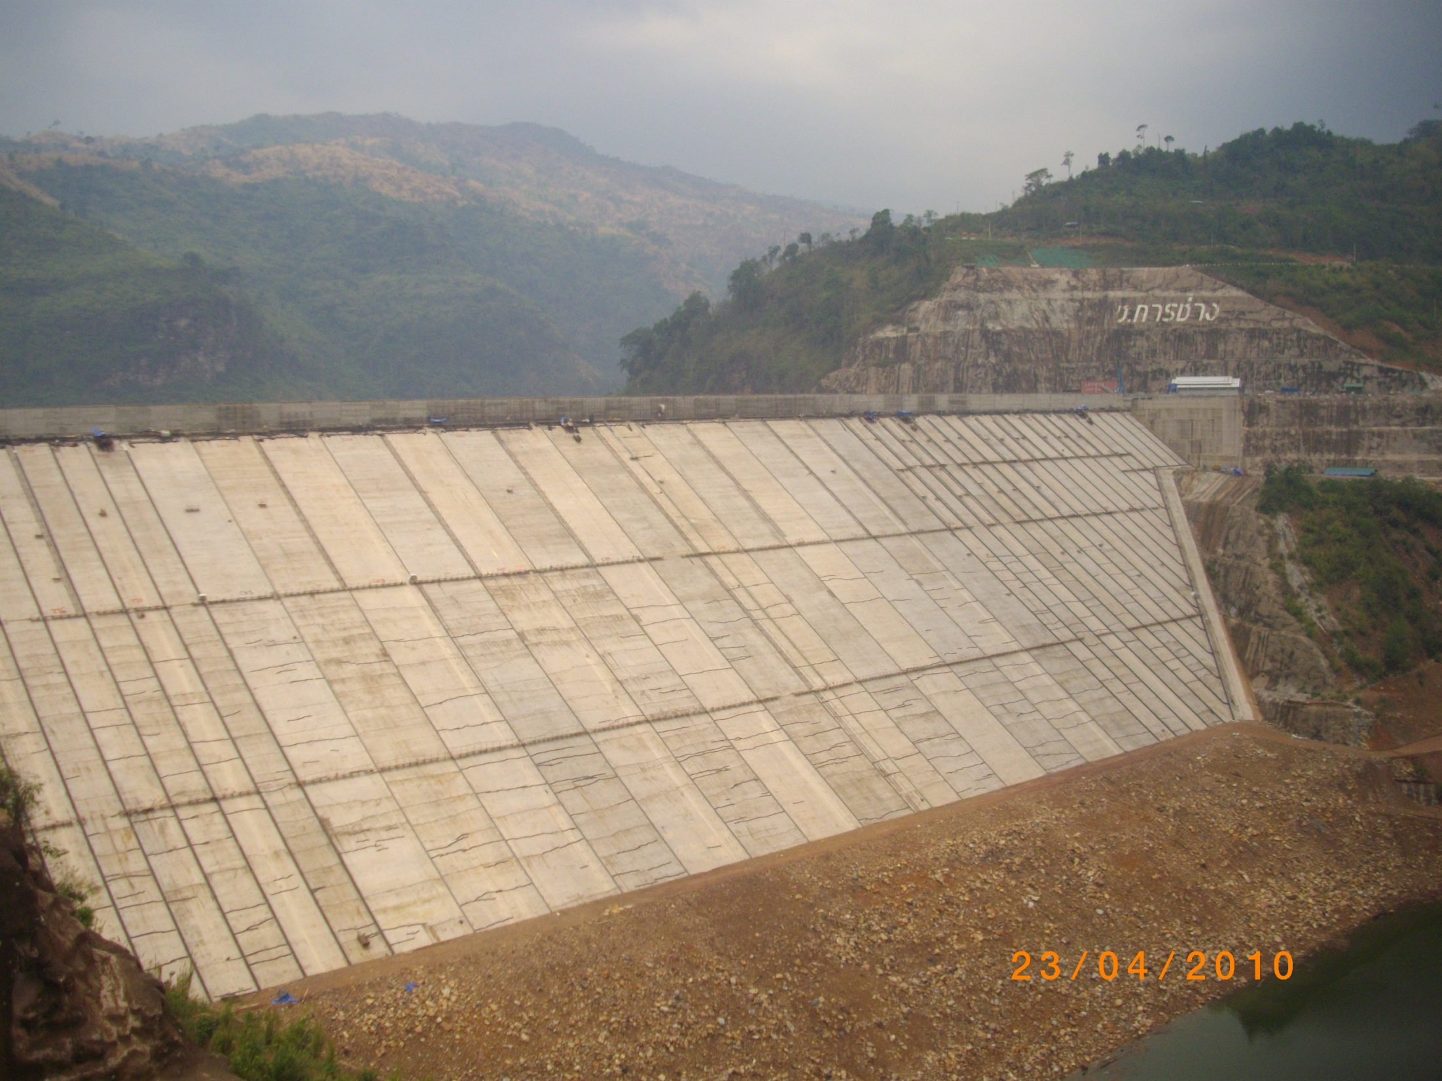
Thank you for your attention

